Slide 1

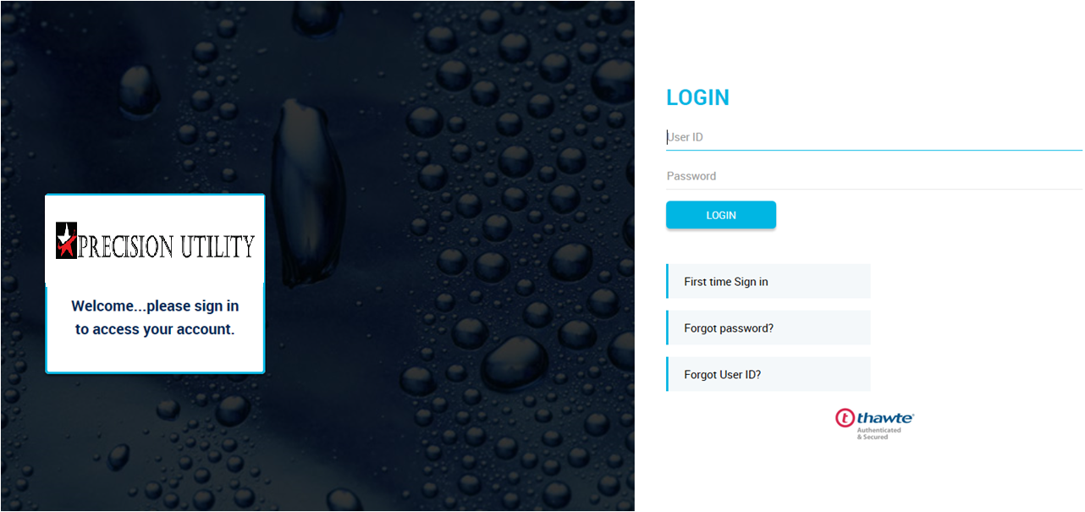
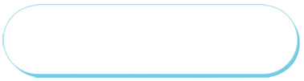
The Login Page is the first page your customers
will see when they visit AVR uOnline
Otherwise, the customer will enter the User ID and Password established at the time of registering
If the customer is a new user, they will navigate to the First time sign-in…

Slide 2

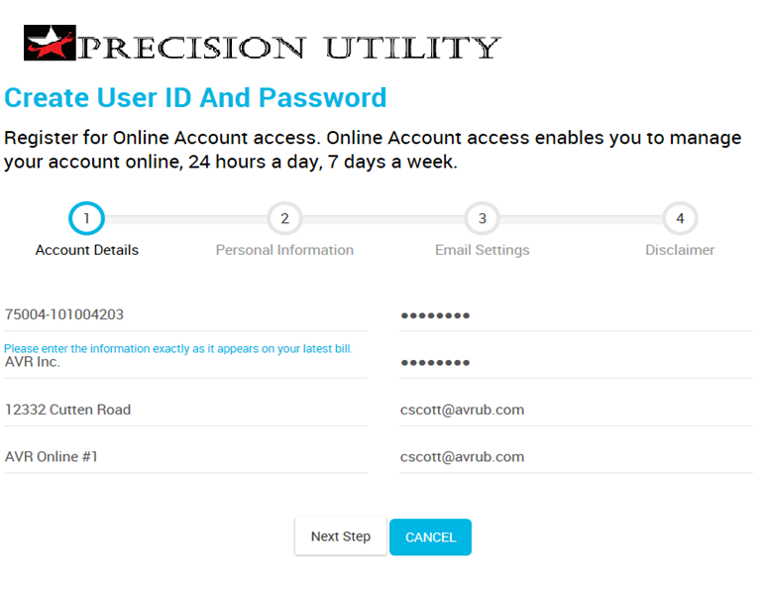


Creating a User ID and Password with 15 digit account number structure
AVR uses 3 validation and verification points when signing up for online use.
1. Entire Account Number
2. Name
3. Service Address
The customer will choose a unique User ID and Password, and enter in the email address they want their emails going to
*Your Service Address may be different than mailing address
The example below shows on the utility bill where the account number structure is located, you must include the 5 digits, the dash and 10 digits to successfully sign up.

Slide 3
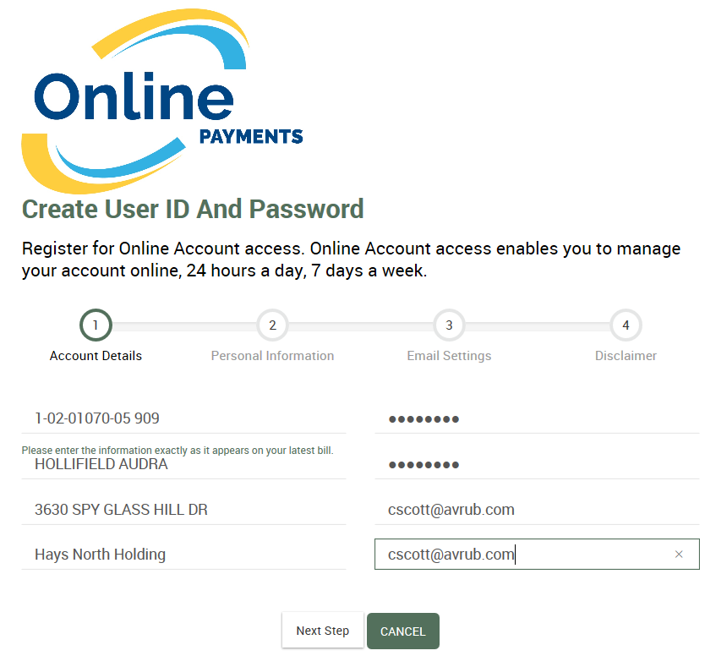

Creating a User ID and Password with 10 digit account number structure
AVR uses 3 validation and verification points when signing up for online use.
1. Entire Account Number
2. Name
3. Service Address
The customer will choose a unique User ID and Password, and enter in the email address they want their emails going to
*Your Service Address may be different than mailing address
The example below shows on the utility bill where the account number structure is located, you must include the 10 digits, the dash and district code, to successfully sign up.
←Account Number, District Code →

Slide 4
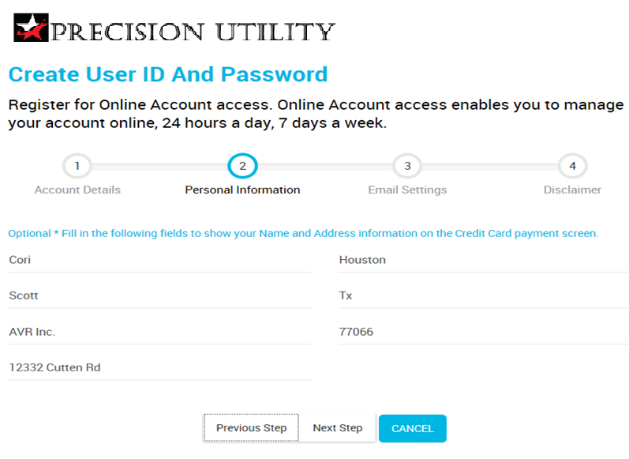
First Time Sign In
Optional – fill out these fields to make the Credit Card Payment process faster, as it auto-populates the information when paying with your card.
Fill out information exactly as shown on your Credit Card – The Name, Address, City, State and Zip Code

Slide 5
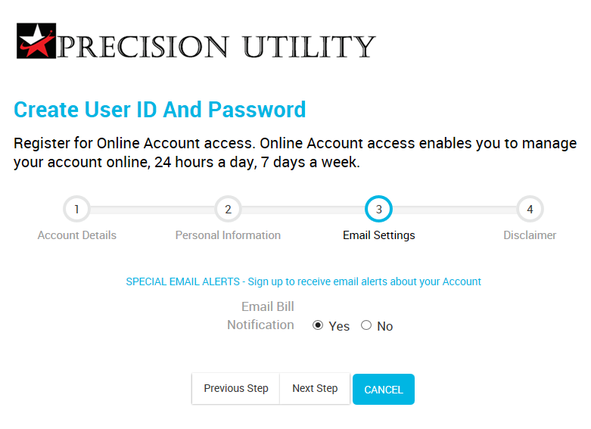
First Time Sign In
Customer initiates the special
E-mail Alerts whether yes they would like to receive them or no you do not

Slide 6
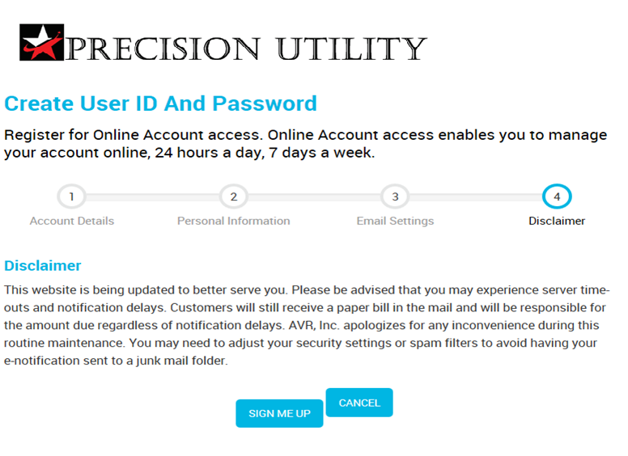
First Time Sign In
When completed entering your information you will click on Sign Me Up! You will now be signed up For online billing/viewing.

Slide 7
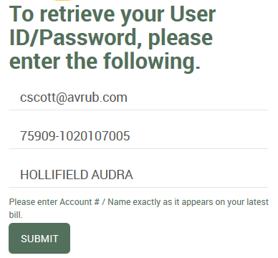
Forgetting User ID and Password with 10 Digit Account
number Structure
Once the customer receives the email with the new password they will need to go back into the
“Login Screen” and enter their temporary Credentials.
The next screen will take them to the
“Edit my Profile” screen where they will change their password then update their profile.
Here is an example on a bill of where to find your information

Slide 8
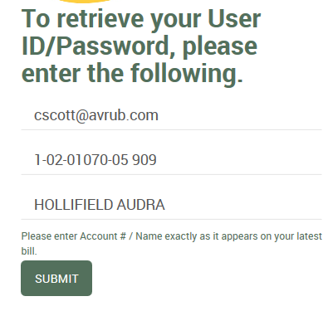
Forgetting User ID and Password with 10 Digit Account
number Structure
Once the customer receives the email with the new password they will need to go back into the
“Login Screen” and enter their temporary Credentials.
The next screen will take them to the
“Edit my Profile” screen where they will change their password then update their profile.
Here is an example on a bill of where to find your information
←Account Number, District Code →

Slide 9
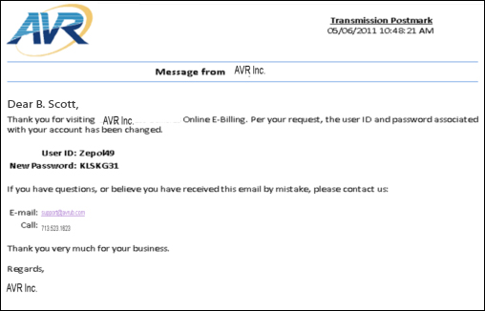
Forgetting User ID and Password
AVR does not validate the original email that the customer used when they first signed up their online account. It ONLY requires an active email.
An email will be sent to the customer with the User ID on file and a temporary Password.
Currently the temporary password does not have an expiration time.

Slide 10
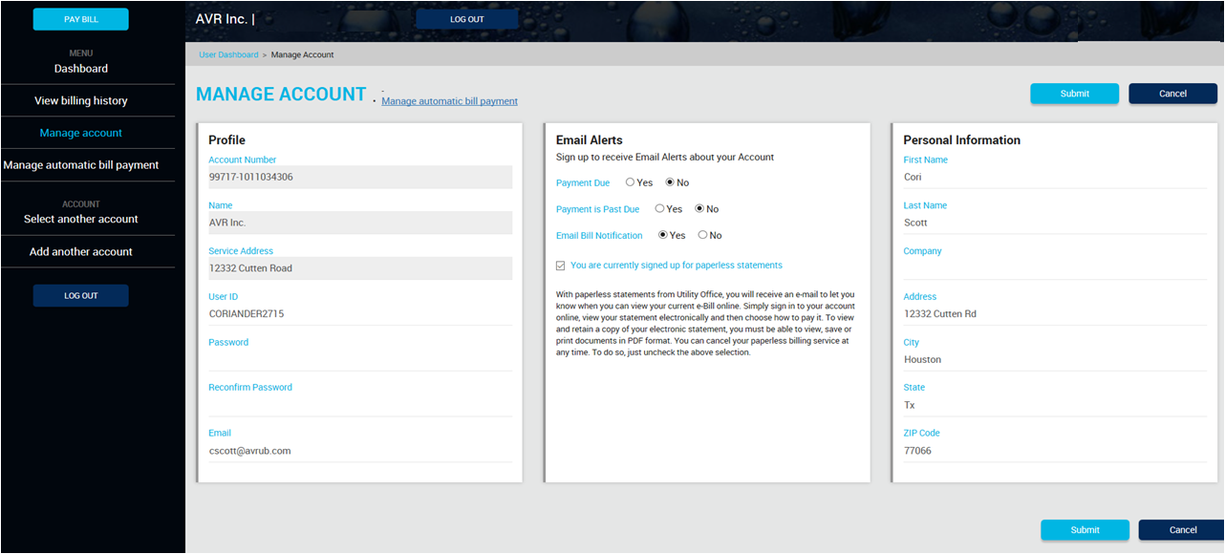
Forgetting User ID and Password
When the user gets the email of their new password, they will need to go back to the log in screen to enter their User ID and the temporary Password.
User will then be redirected to the “Manage Account” screen to change their Password.

Slide 11
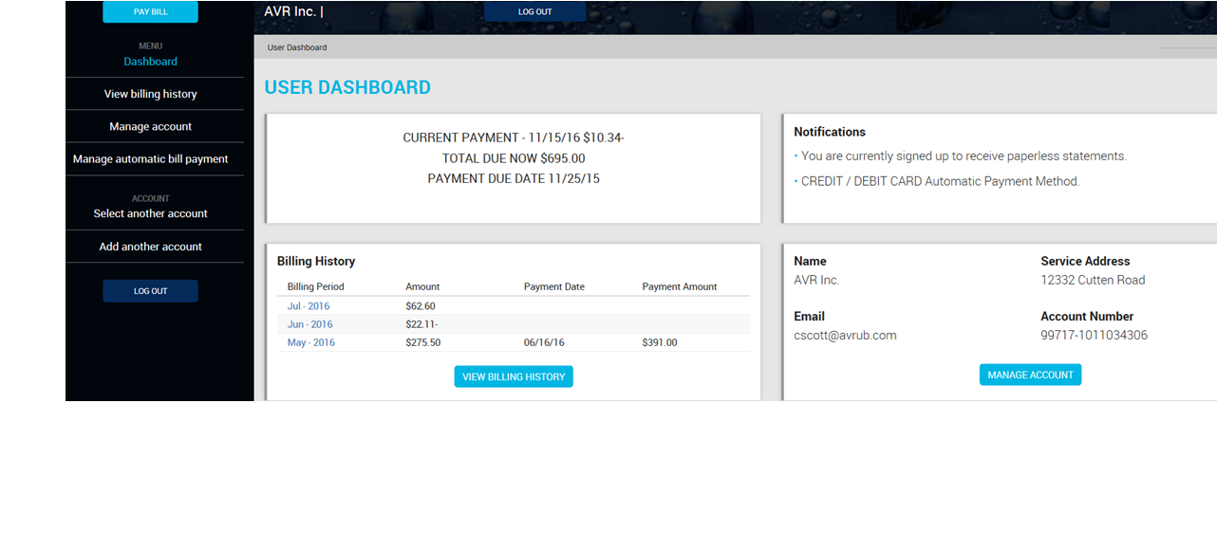
Account Overview
Sign up for Bank Draft or Credit Card Recurring Payments.
To View their Billing History click View Billing History This shows all billing history.
Click on the billing period to view Current Bill Statement
ONLY when highlighted blue. The User can now view previous months bills.
The user can “Manage Account”, here they can change password, email and sign up for paperless

Slide 12
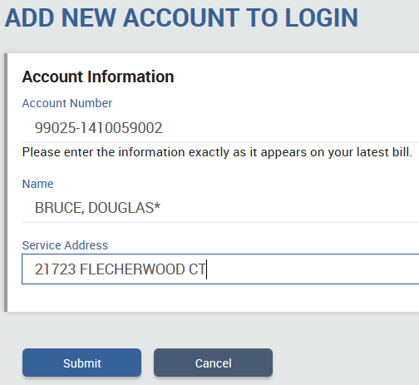
Add New Account with 15 Digit Account
Number Structure
A customer can sign up another one of their accounts
by clicking on the Add another account button just above the Log Out button.
The next screen will take them to the
“Add Account” screen where they will be able to add an additional account to the one they already have signed up
If an account goes to a final, they can now remove the old account and just have the new account for their login without having to delete the whole account and start over.
The example below shows on the utility bill where the necessary information is located to fill-in the account number, on the new account login screen for customers with a 15 digit account.

Slide 13
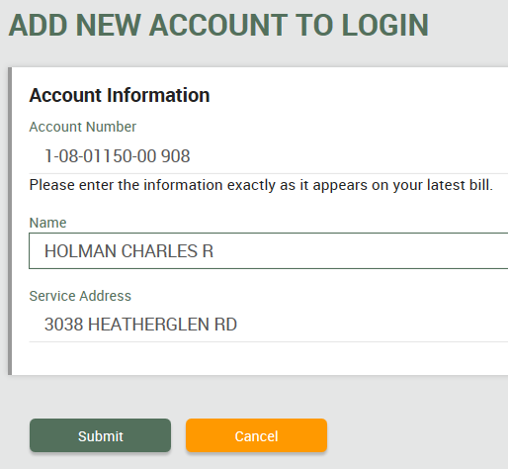
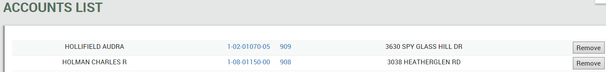
Add New Account with 10 Digit Account
number Structure
A customer can sign up another one of their accounts
by clicking on the Add another account button just above the Log Out button.
The next screen will take them to the
“Add Account” screen where they will be able to add an additional account to the one they already have signed up
If an account goes to a final, they can now remove the old account and just have the new account for their login without having to delete the whole account and start over.
The example below shows on the utility bill where the necessary information is located to fill-in the account number, on the new account login screen for customers with a 10 digit account.
.
←Account Number, District Code →

Slide 14
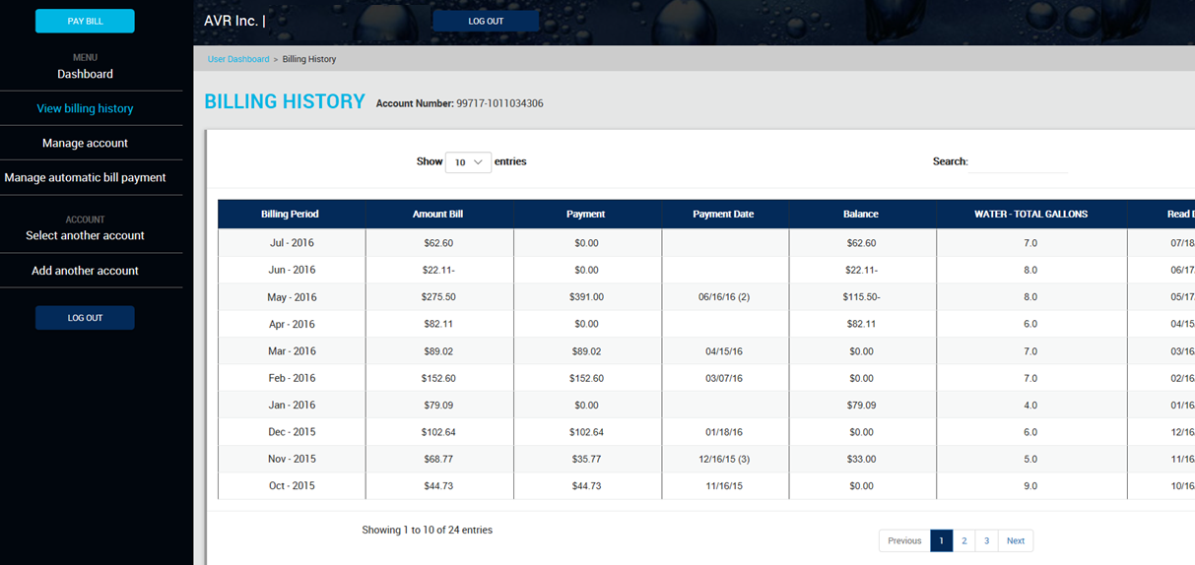
Billing History

Slide 15
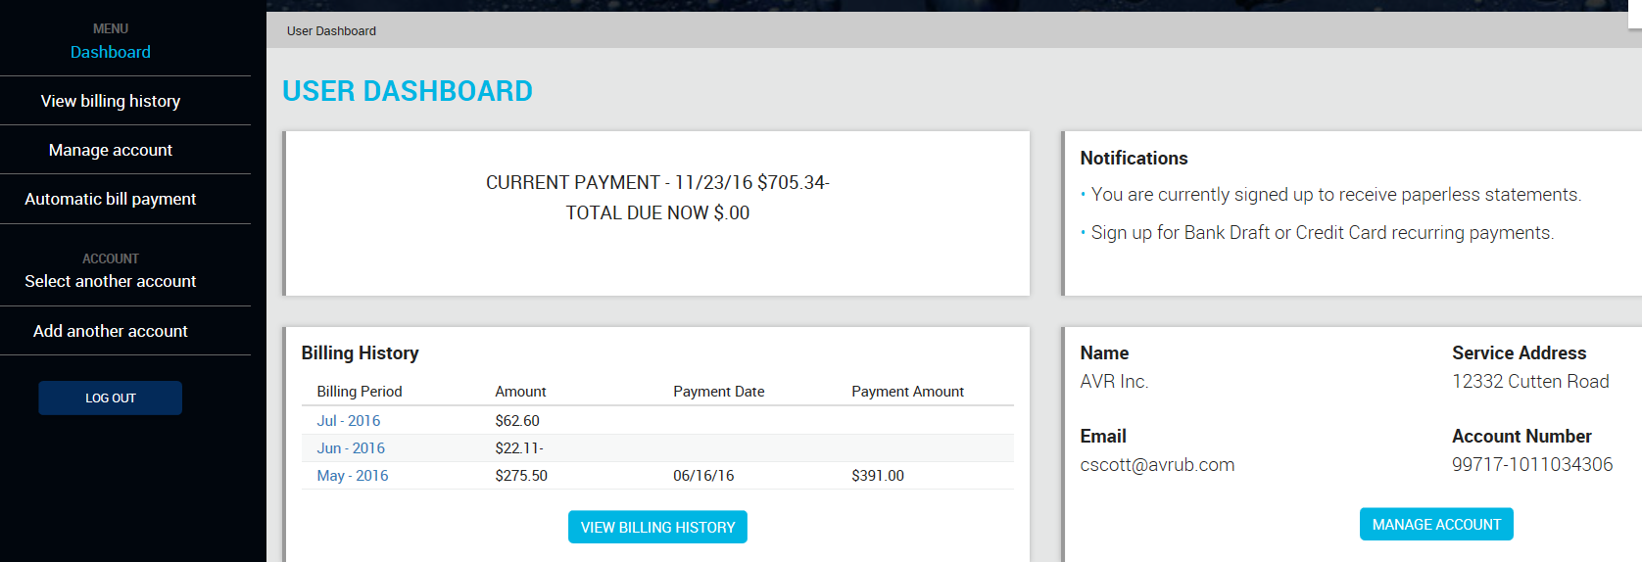
Sign up for Paperless
To sign up for Paperless, The user will first click on Manage Account.

Slide 16
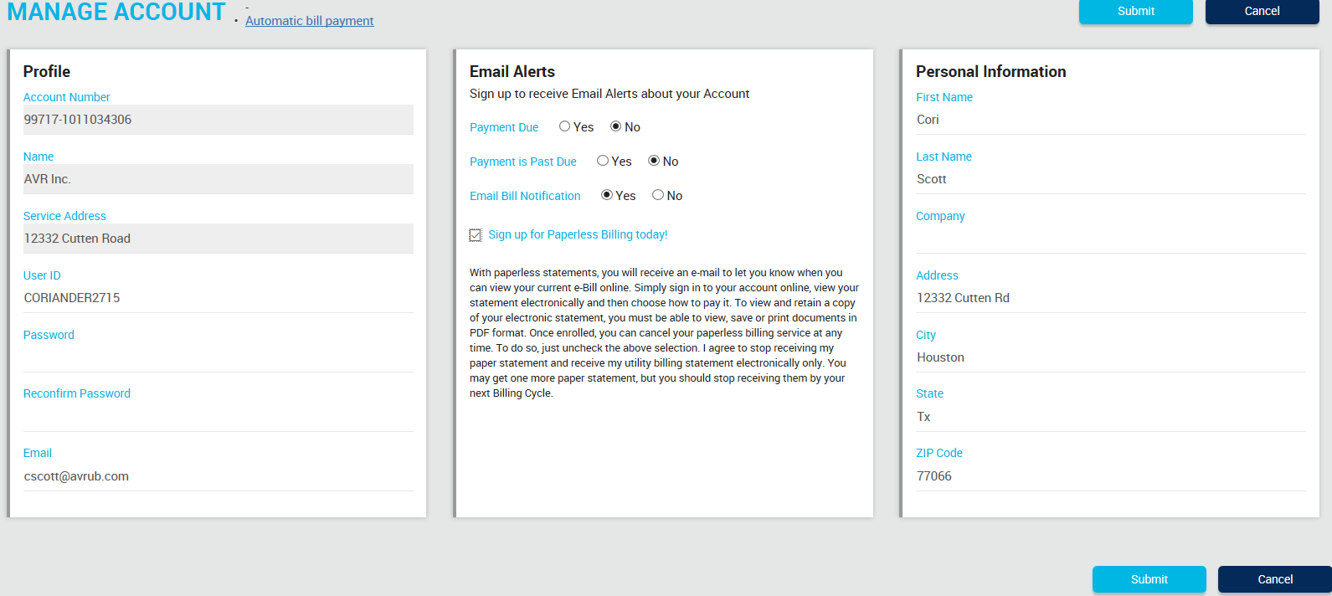
Sign up for Paperless
All it takes to sign up for paperless is checking the box next to “Sign up for Paperless Billing” today! Then Submit to update your Profile.
Soon after you have signed up you will receive an email saying “Thanks for Going Paperless”

Slide 17
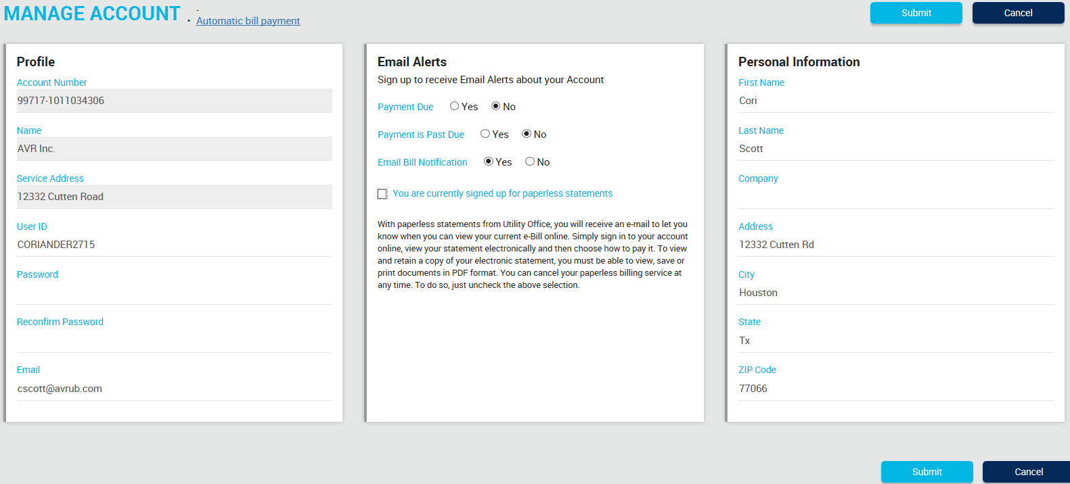
Cancel your Paperless Bill
To cancel Paperless bill: 1. simply uncheck the “You are currently signed up for paperless statements” and then 2. click “Submit”

Slide 18
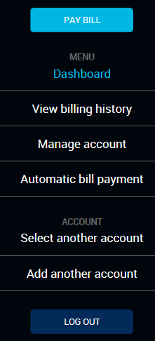
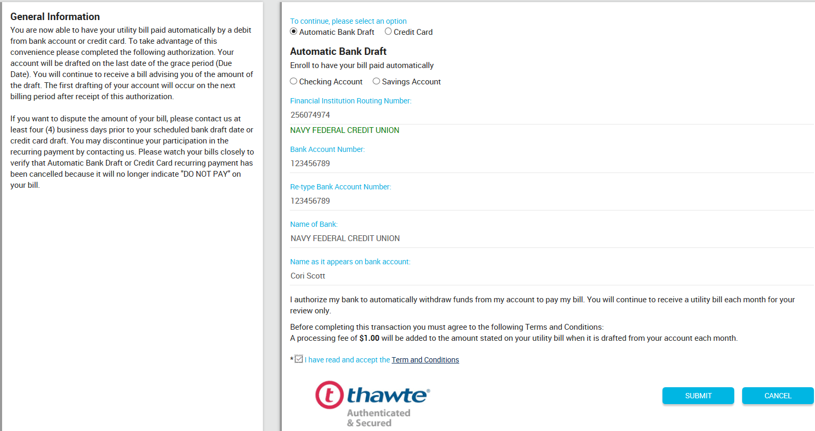
Sign up for Recurring ACH
To sign up for Bank Draft Recurring, The user will first click on Automatic bill payment.
Signing up for Recurring Bank Draft is easy, you simply: 1. Choose Automatic Bank Draft. 2. Choose if it is a Checking or a Savings account. 3. AVR now verifies the Routing Number and auto populates the name of the Financial Institution *This should cut back on the amount of Rejects received* As well as verifying the Bank Account number.
4. Check the “I have read and accepted the terms and conditions”
5. Once the user completes filling all their information out they will click Submit to save application.
Once signed up, the user will get an email saying “Thanks for signing up for Recurring”.

Slide 19
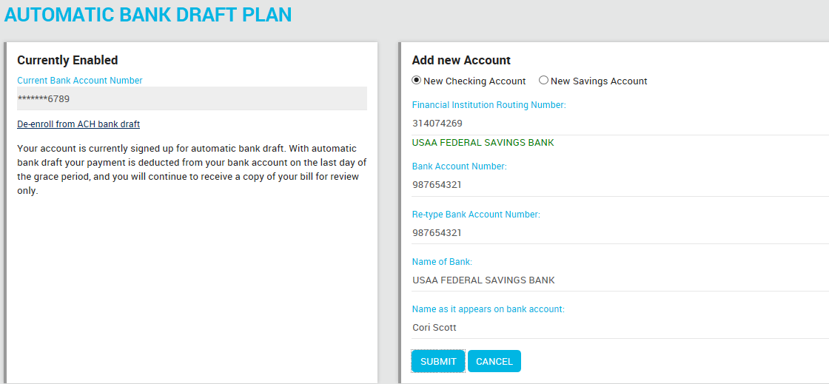

Edit Recurring ACH
Customers can now edit their Bank Draft information without de-enrolling

Slide 20
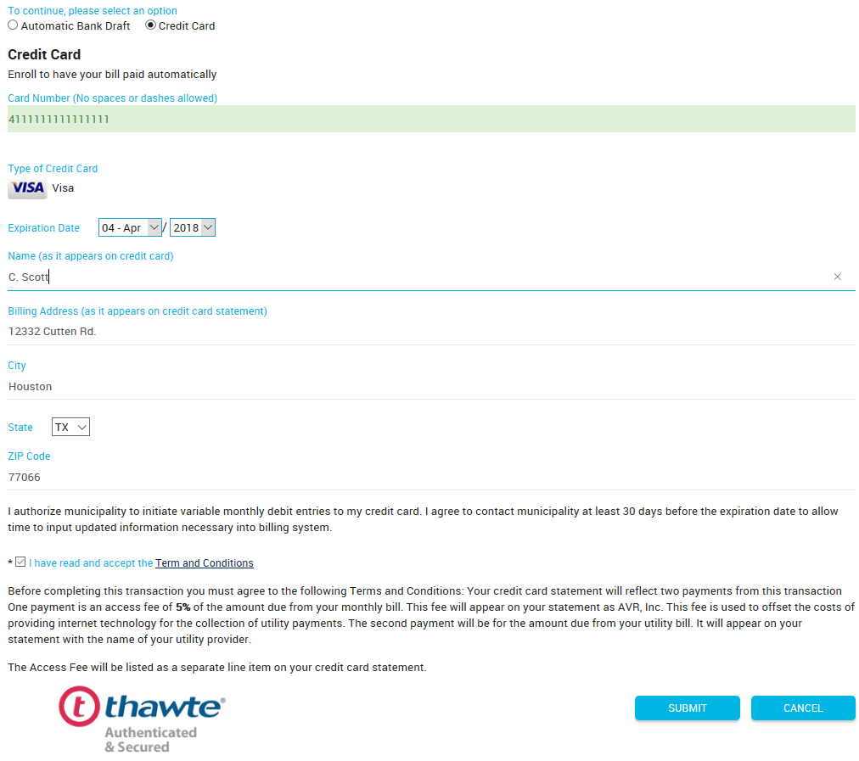
Sign up for Recurring Credit Card
To sign up for Bank Draft Recurring, The user will first click on Automatic bill payment.
Signing up for Recurring Credit Card is easy, you simply: 1. Choose Credit Card. 2. Enter the card number and the card type will auto populate, then the rest of the card information. 3. Check the “I have read and accepted the terms and conditions”
4. Once the user completes filling all their information out they will click Submit to save application.
Once signed up, the user will get an email saying “Thanks for signing up for Recurring Credit Card”.

Slide 21
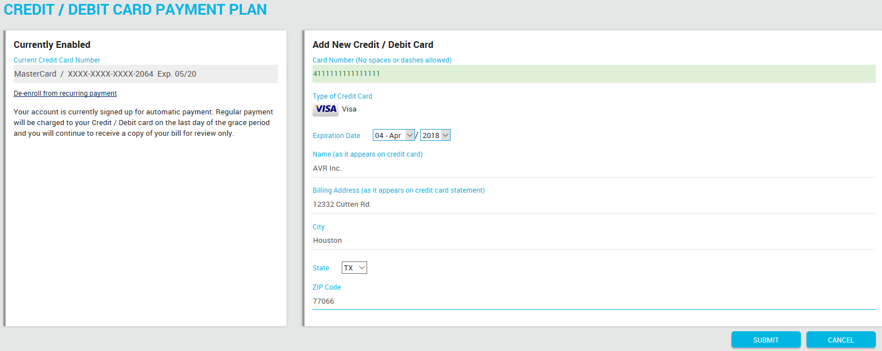

Edit Recurring Credit Card
Customers can now edit their credit card information without de-enrolling

Slide 22
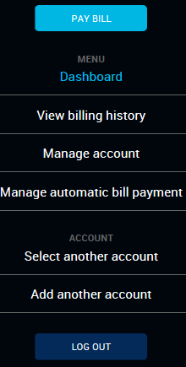
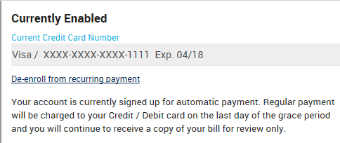
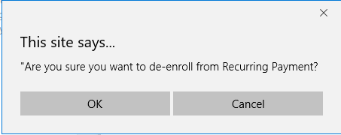
Cancel Recurring Payment Option
Credit Card or ACH
When cancelling Recurring payments the user will click on the Manage automatic bill payment.
User will then select De-enroll from Recurring Payment.
When they click on that this box will pop up asking if you are sure. When you click ok, you will then be De-enrolled from Recurring Payments.

Slide 23
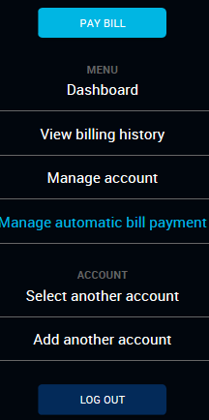
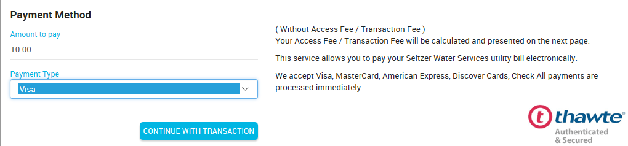
Making a One Time Payment
User will click on “Pay Bill” button and will be redirected to a screen allowing them to:
1. Choose an amount they would like to pay
2. Select the “Payment Type” and
3. “Continue with Payment”.

Slide 24
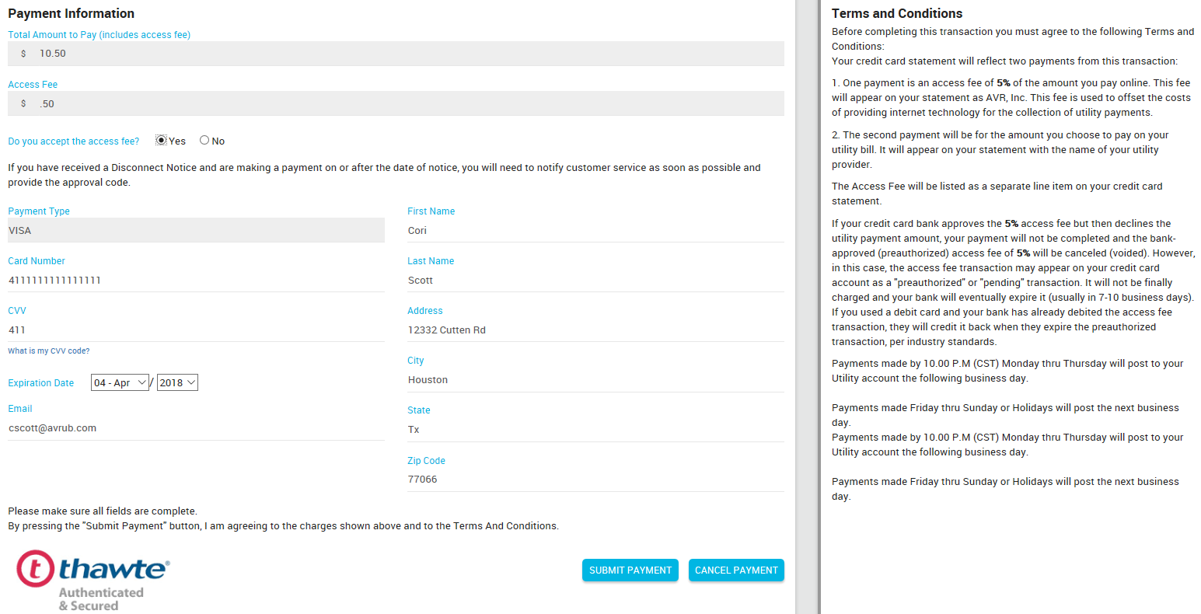
Making a One Time Payment
The user will then enter all their card or check (whichever they are paying with) information and then click
“Submit Payment” button The user will then be placed in a pack file.

Slide 25
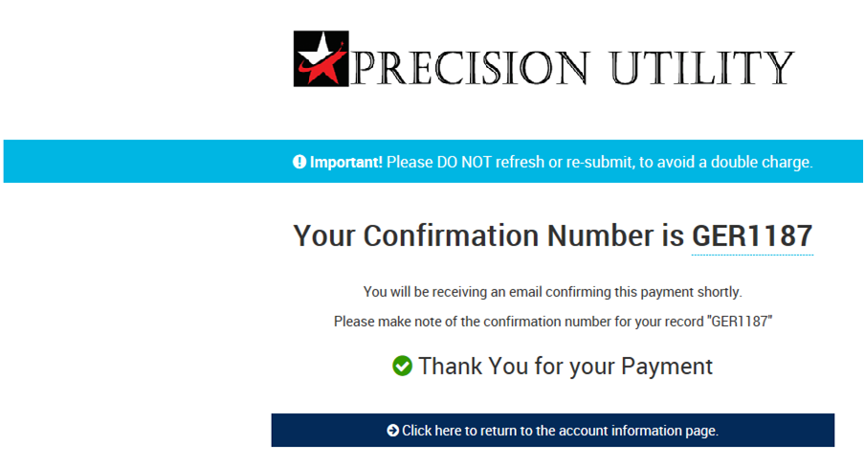
Making a One Time Payment

